Slide 1
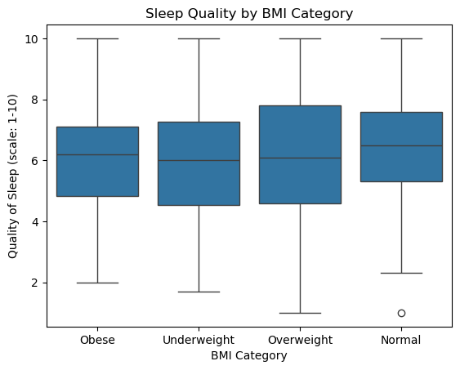
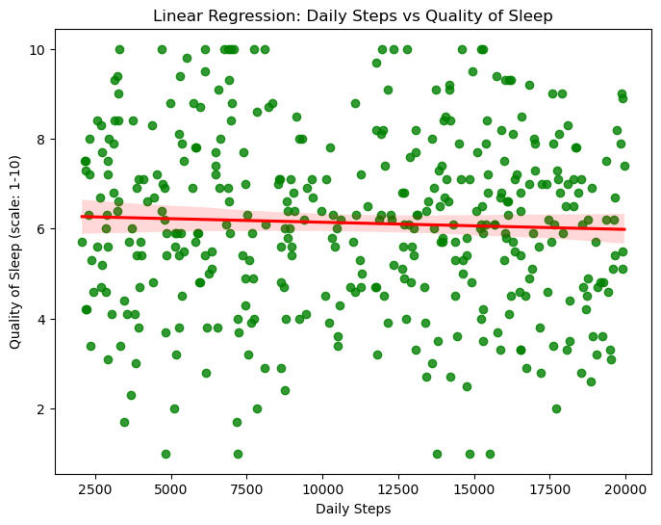
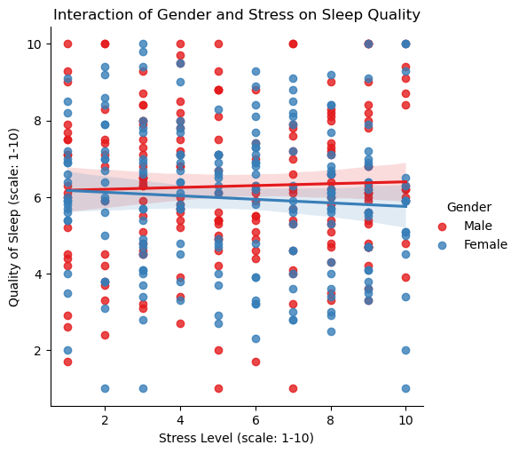
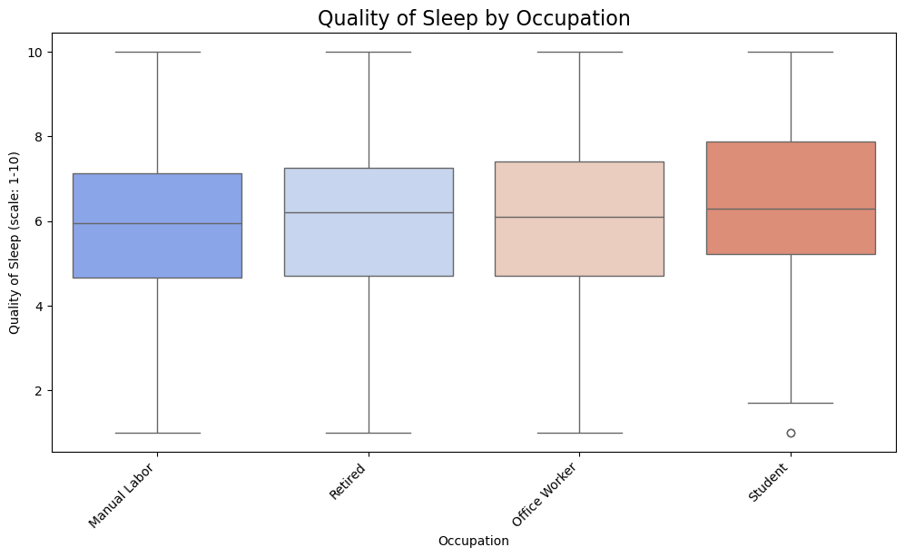


Dawood Hussain¹, Hibak Ramadan², Badder Ul Zaman Qamar³, Muhammad Hamza⁴
^{Group 34}
Exploring the impact of lifestyle factors on sleep health
Research Question
What is the correlation between lifestyle factors (such as daily steps, body weight, occupation, stress ) and sleep health interaction of gender?
Motivation
This study examines the connection between lifestyle factors and sleep health. It investigates how physical activity, stress, and occupation impact sleep quality and sleep duration. The findings can inform strategies to promote better sleep and improve overall well-being.
Data and Methods
Data Source: The dataset used in this study was sourced from Kaggle and consists of 400 participants aged 18 -90. Data were collected via a structured survey that included information on various lifestyle factors (physical activity, sleep quality, stress, etc.).
Methodology: A statistical analysis was conducted using Pearson's correlation coefficient and a logistic regression model to identify trends between lifestyle factors and sleep health indicators. Multiple linear regression models were applied to account for potential confounding variables, such as occupation and gender. All analyses were carried out using Python version 3.
Results
Figure 3: This box plot compares the quality of sleep among individuals from different BMI categories. The data reveals that while the median sleep quality across all groups (obese, underweight, overweight, and normal BMI) is around 6, those in the normal BMI category report slightly higher average sleep quality, with some individuals experiencing much higher quality sleep. The distribution of sleep quality appears relatively consistent across BMI categories, with no significant differences in the interquartile ranges. These findings suggest that BMI may not have a substantial impact on overall sleep quality, though other factors may influence individual experiences.
Figure 1: This analysis explores the potential link between daily steps and the quality of sleep. This linear regression model shows that there is little to no significant relationship between the number of daily steps and sleep quality. Despite a wide range of daily steps, the sleep quality scores remain consistently around 6 on a scale from 1 to 10.
Figure 4: This scatter plot investigates how stress levels and gender interact to influence sleep quality. Both male and female participants show a similar trend: as stress levels increase, sleep quality remains relatively stable, with only a slight decline. While the stress-sleep relationship is consistent across genders, the data suggests that stress may not have a significant impact on sleep quality in this sample, regardless of gender.
Conclusion
This study found that daily steps, occupation, and BMI had minimal impact on sleep quality, with most participants reporting consistent scores around 6. Stress levels showed a weak relationship, with a slight decline in sleep quality as stress increased. The results suggest that other factors, such as stress management or environmental influences, may play a more significant role in sleep quality than the variables examined. Further research is needed to better understand the complex interactions contributing to variations in sleep quality.
Figure 2: This box plots shows that manual laborers and retirees report similar average sleep quality, while office workers have more consistent sleep patterns. Students exhibit greater variability in sleep quality, likely due to academic demands and irregular schedules.
For further information scan on this

